Slide 1


Orphic Finance
ARCHEIO TOKEN REGISTRY

Slide 2

Orphic Finance Team
Joined the ecosystem during the Serum Hackathon
@jpcreedon – 6 years in crypto, 10 years product management
@thanosv – 5 years in crypto, 30 years in development
@lsxliron – 1 year in crypto, 15 years in development
@mijkenator – 3 years in crypto, 20 years in development
@mhuang88 – 2 years in crypto, 15 years in development
https://github.com/IceBlockDev/archeio-solanaszn

Slide 3
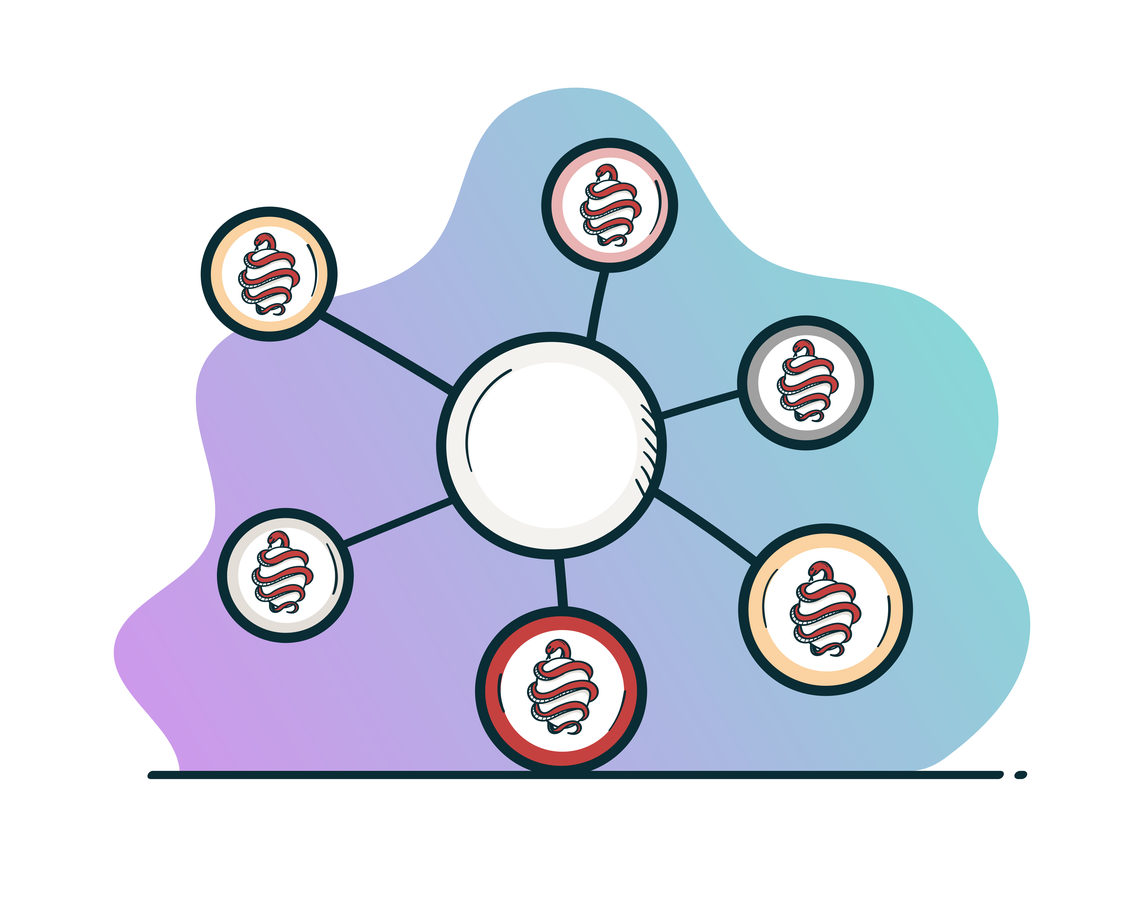
Archeio Introduction
Why Build Archeio?
We needed to figure out how much our Cosmic Eggs were worth (ultimately this is why we went down this road) – we needed to tie a stake account to a given token
We wanted to see how our balances changed over-time – added a table behind Archeio that will create history over time (per epoch change or per minute and creating various time slides through a candle keeper)
Enable users to create entries via their Programs or via the Archeio UI
Enable users to create valuation methods for tokens (whether changed on epoch via pointed account or a dex or series of inputs via TWAP or VWAP)
Create an immutable token registry
https://github.com/IceBlockDev/artifacts/blob/main/wp/Orphic-Finance-Whitepaper-v0.2.pdf - section 4

Slide 4
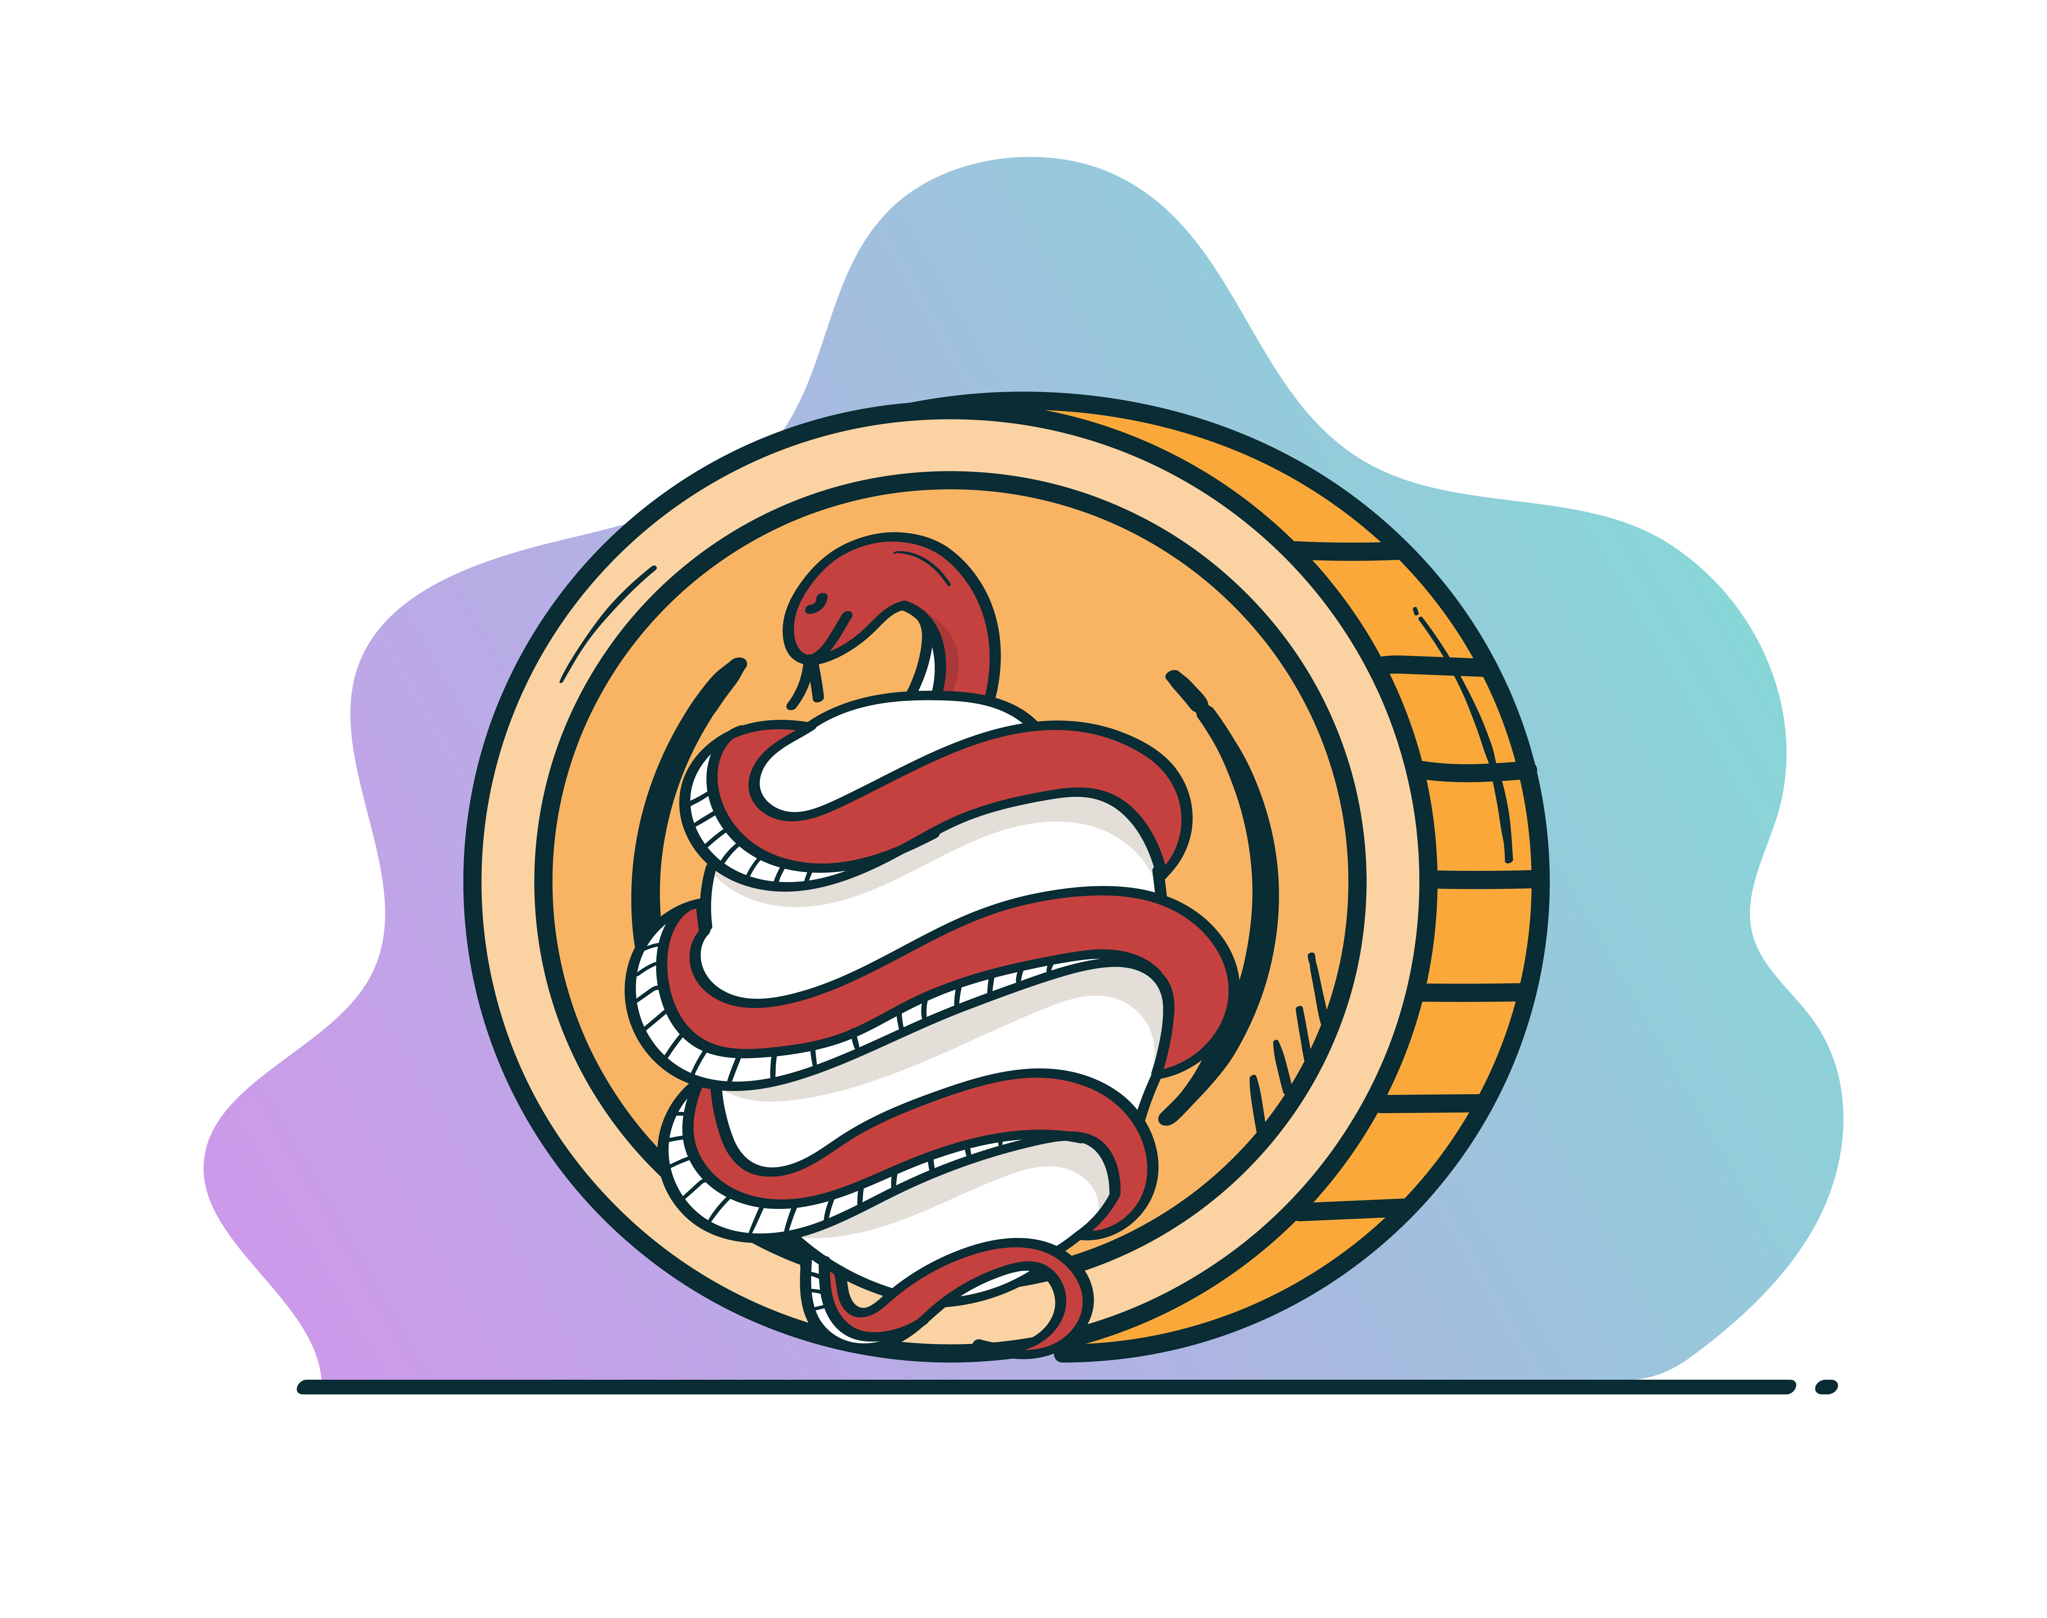
Archeio Features
Required Fields
Non-required fields
Name
Token Ticker
Mint Address
Mint State
Circulating Supply
Auth
Collateral (to be integrated)
Project URL
Icon
Normalized Version (unique)
Value Method
Historical Flag
Listed Locations
Borrowing Rate
Lending Rate
Tags
Parentage – create a group of entries for NFTs or tokens like “Cosmic Eggs”

Slide 5
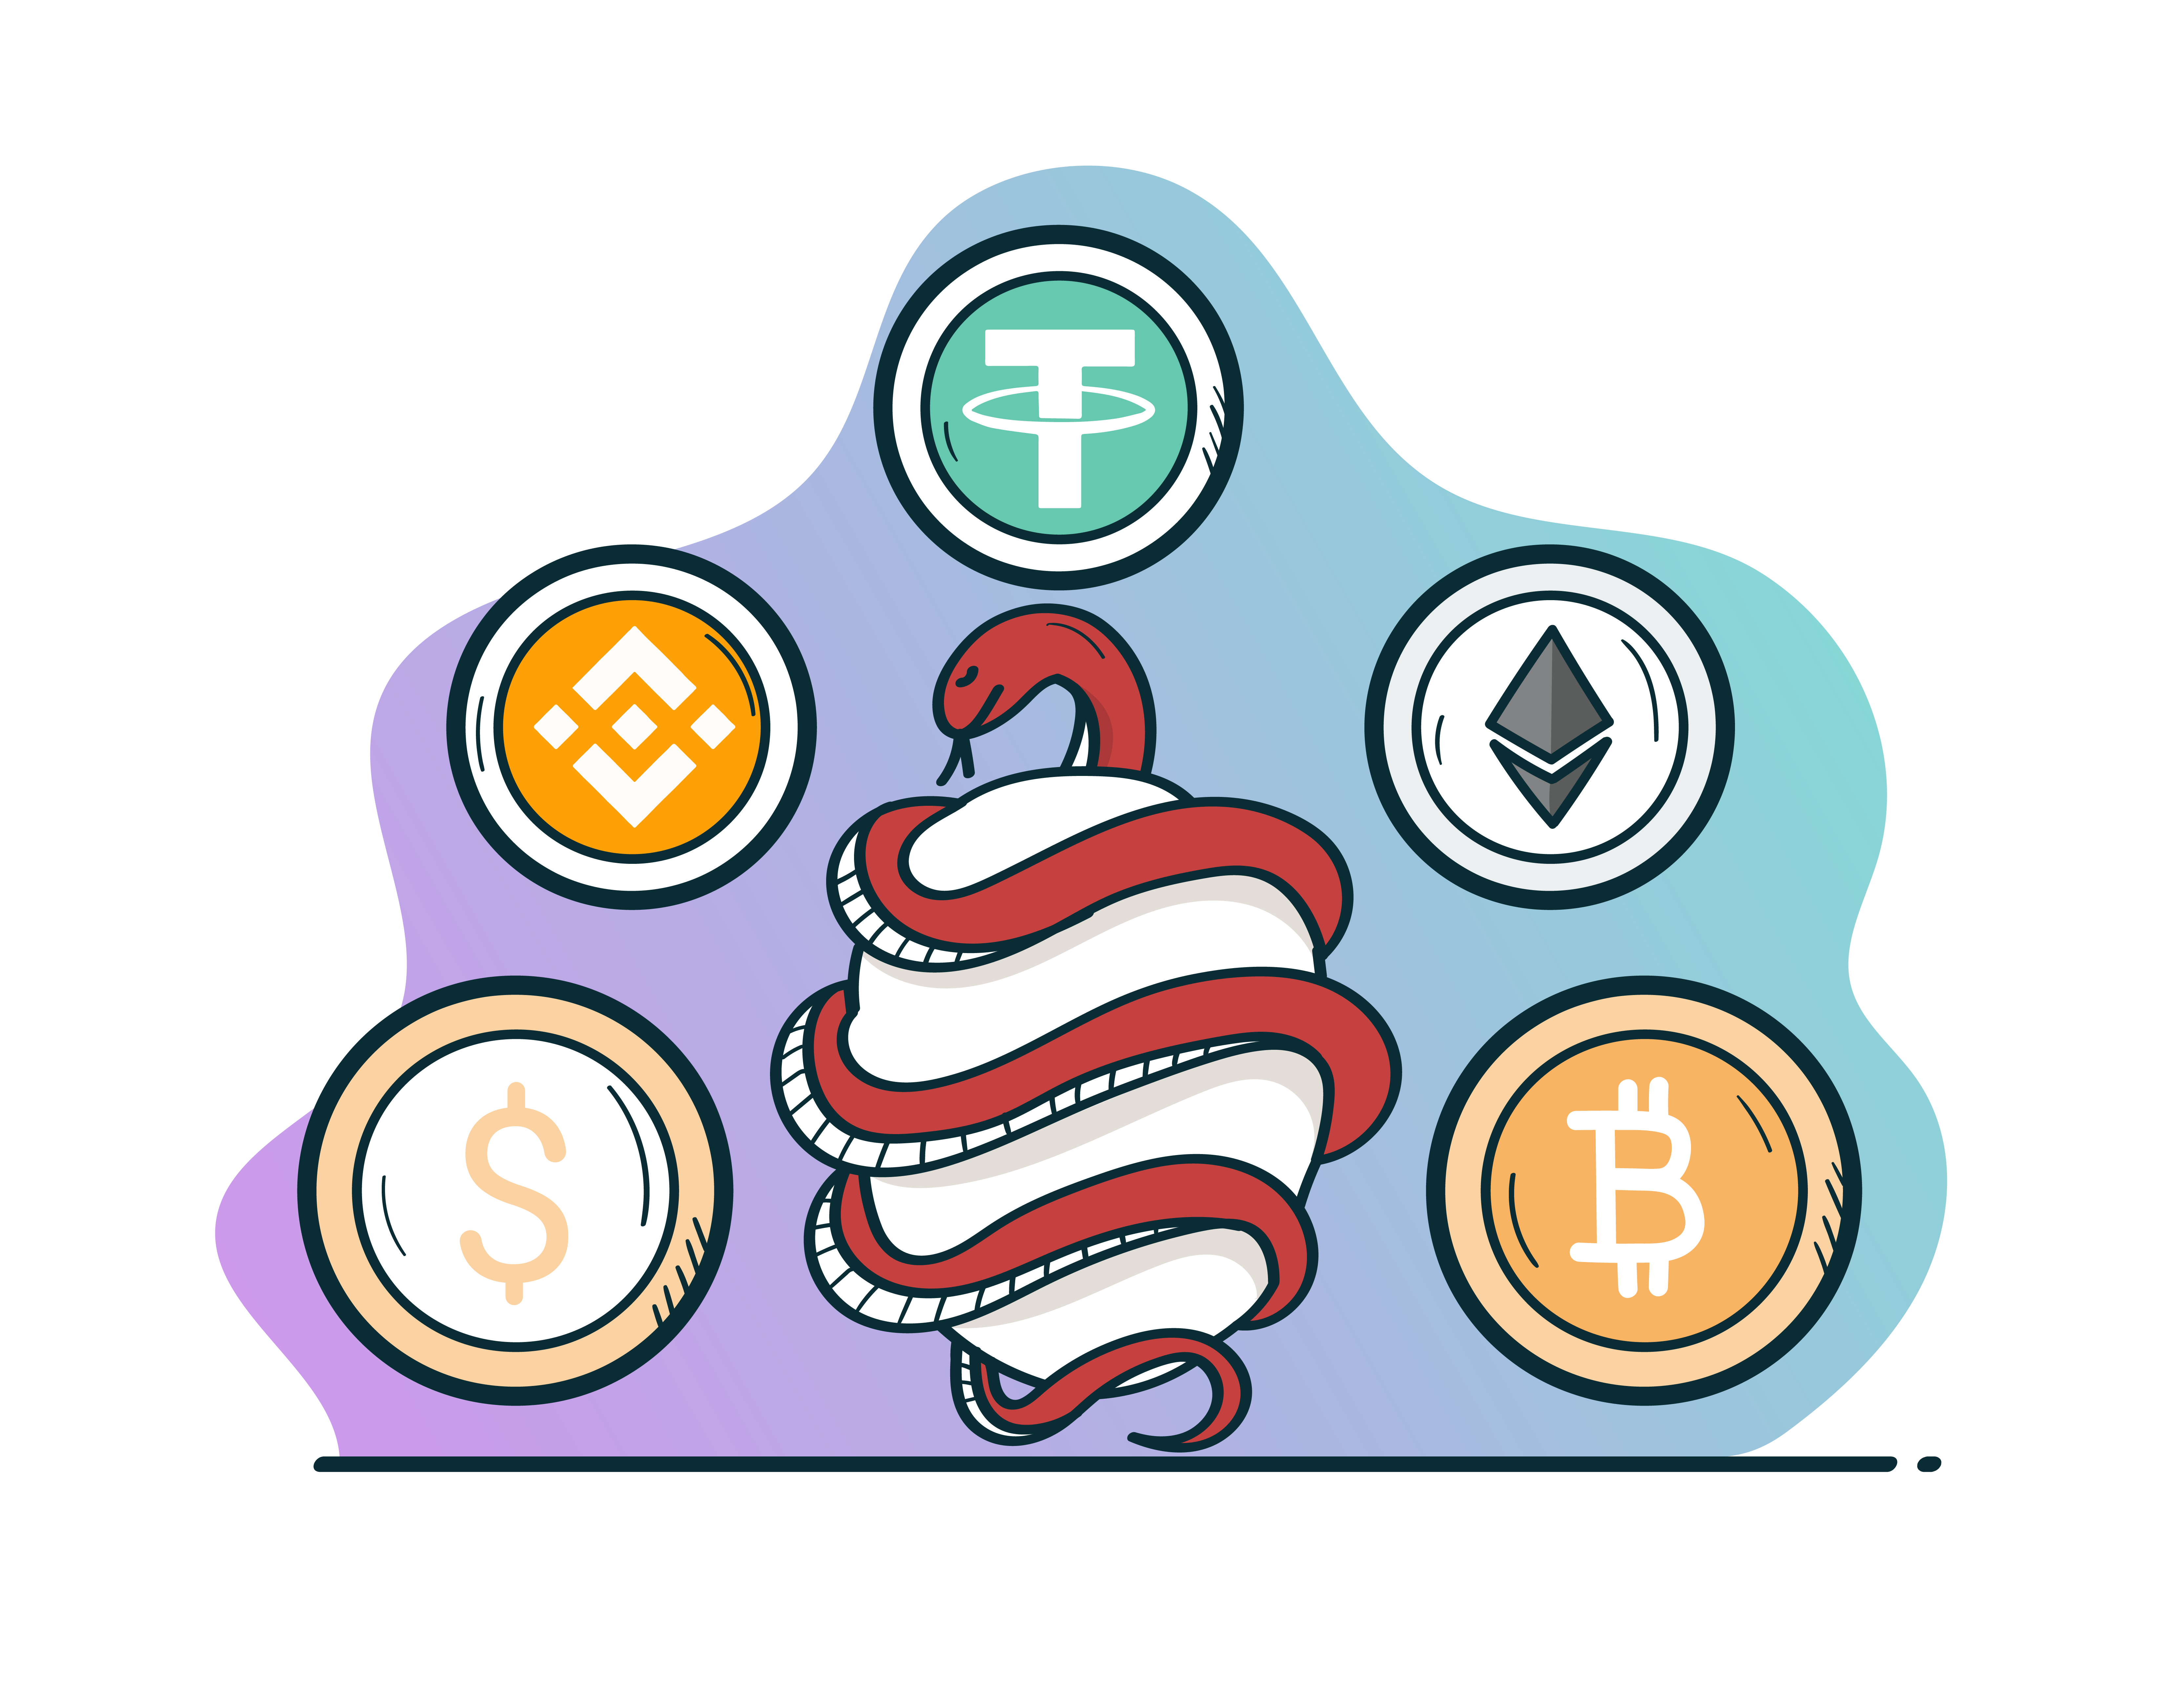
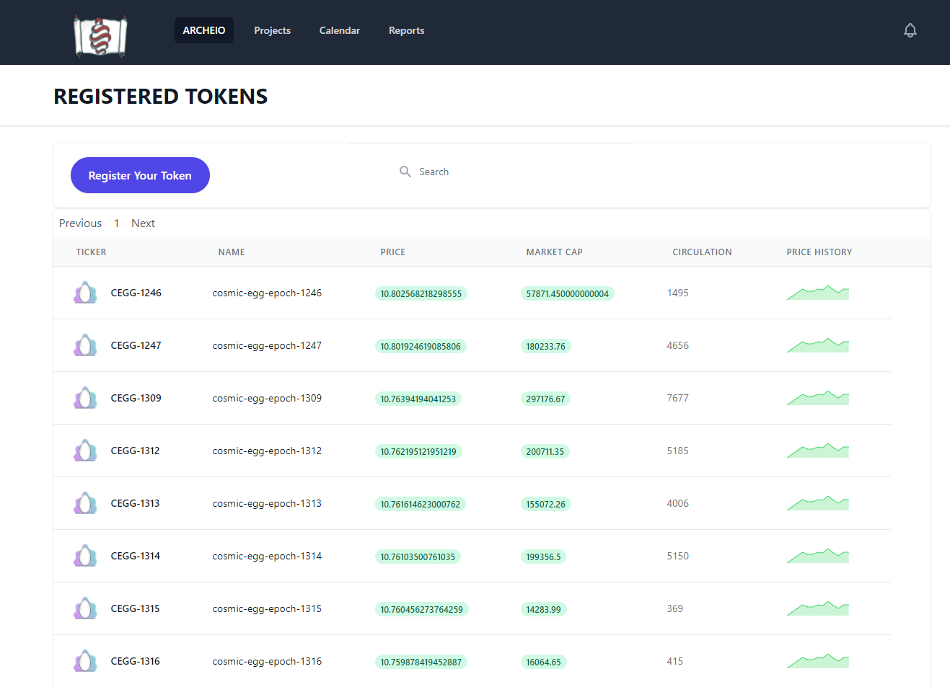
Archeio Token List
Allow users to create a token entry via UI and make it discoverable (via Solana Tags or custom user tags)
Users can drill-down to see more information including:
Historical Data
Data extraction (by frequency)
Token Markets (where you can interact with a token – will capture through service integrations)
Token Holders (list of wallets holding a given token on Solana – if applicable)
Token Registry Changes

Slide 6

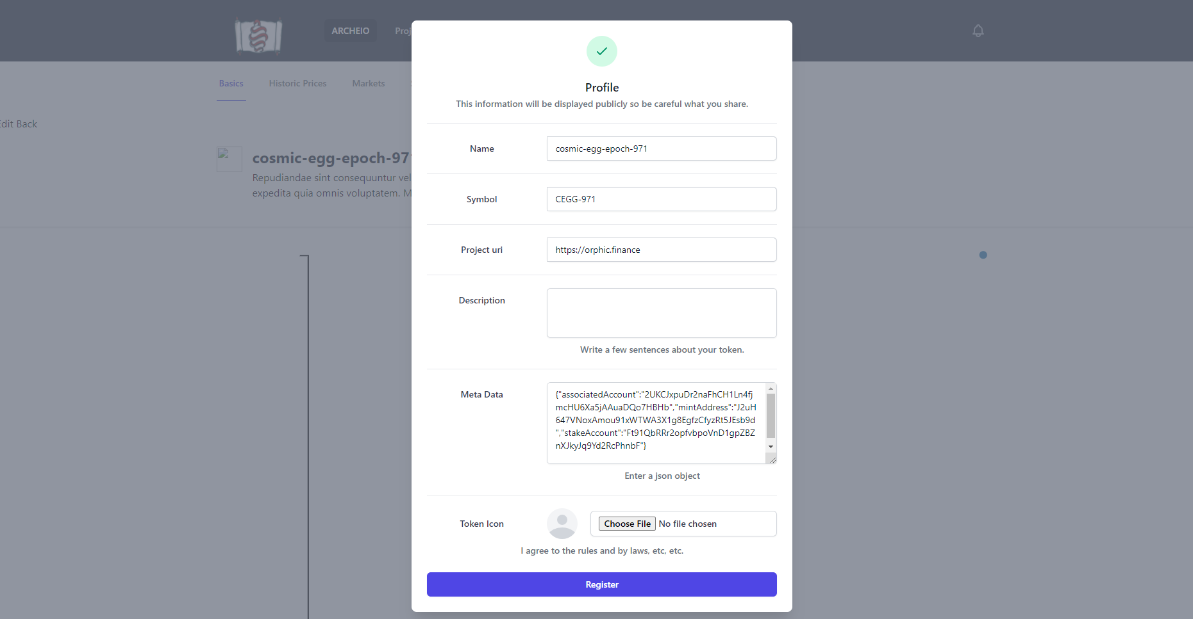
Archeio Creation
Example record created via Cosmic Eggs program
Users can interact with Archeio programmatically or manually via the UI
Users can paint their entries with Meta data including calculations for value
Users can choose to have Archeio store history or just provide a spot value
API DOCS for Archeio

Slide 7

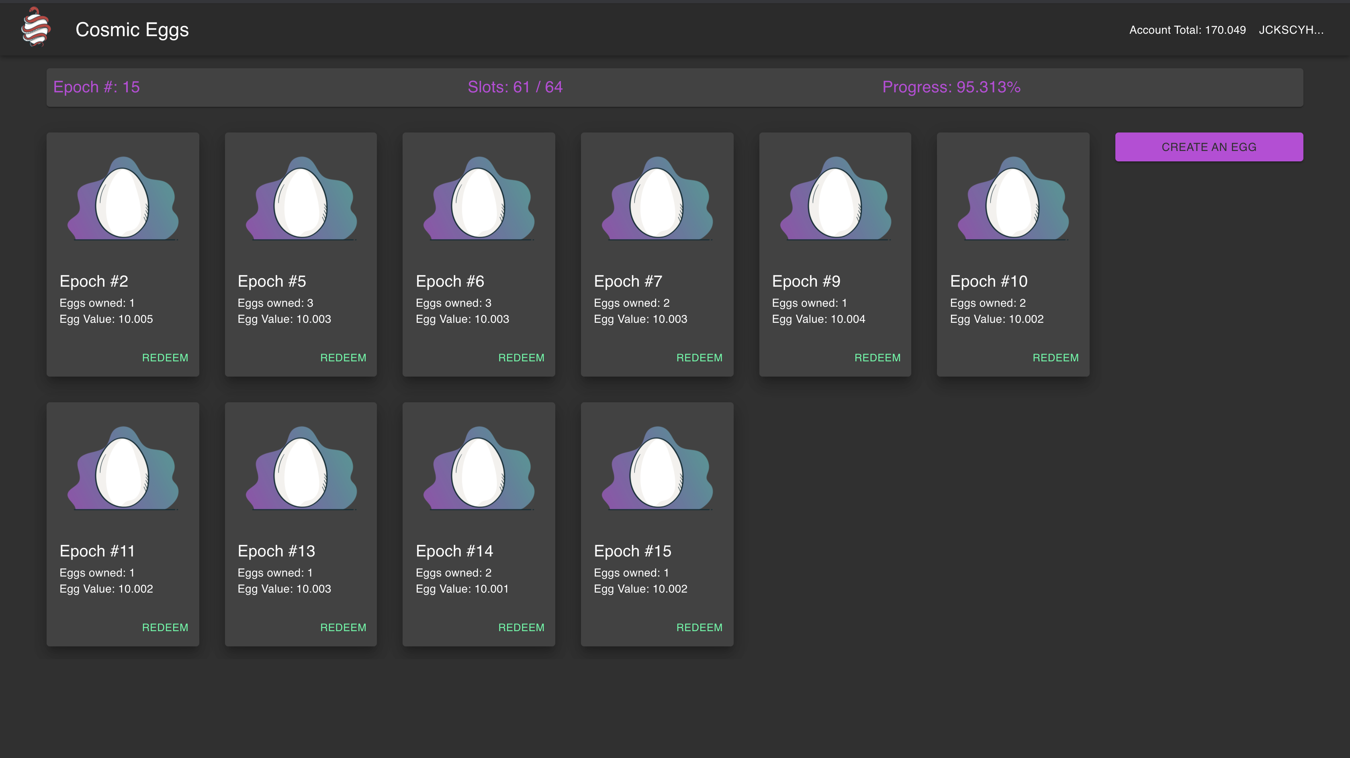
Cosmic Eggs → Archeio Integration
When the first Egg of an epoch is created (someone creates it) Archeio adds an entry to the Token registry
Cosmic Eggs program automatically sends meta information to Archeio, which creates the listing
Archeio uses the stake account and circulating supply to create its’ listing

Slide 8
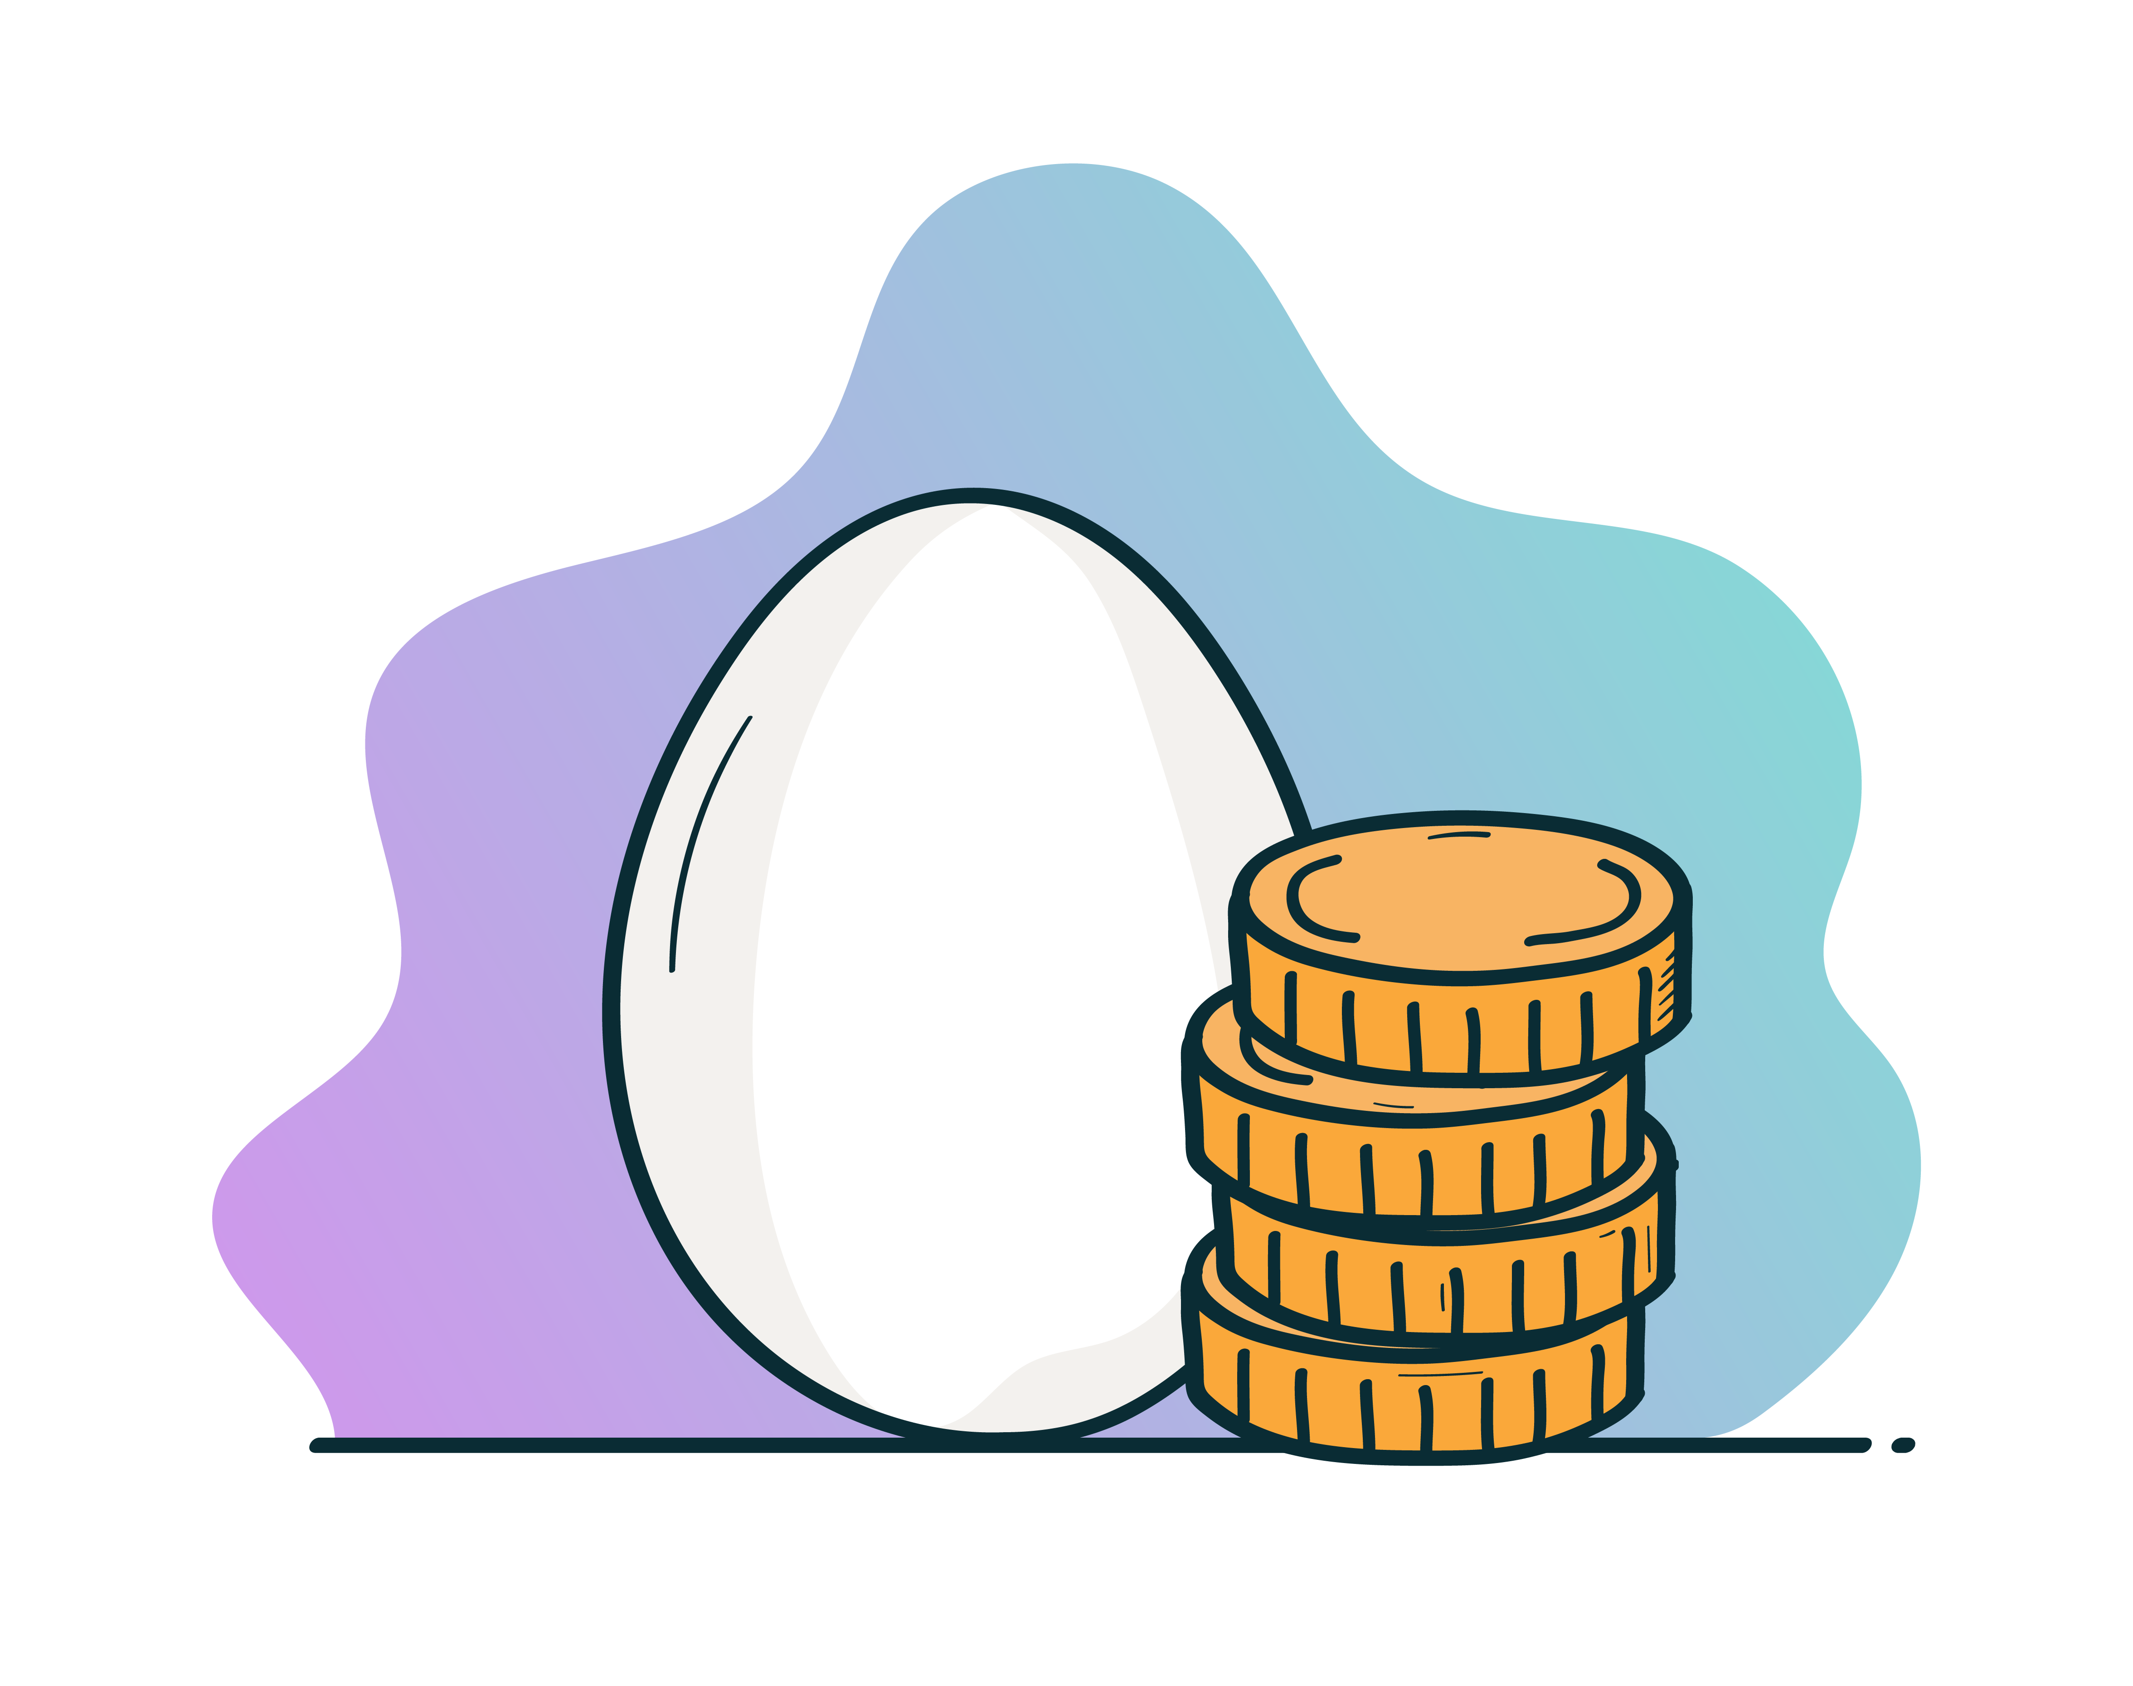
Archeio Monetization
Listing creation/modification/removal (minimal fee / to prevent hammering service)
Posting Collateral (potentially leverage-able) – forfeiting of collateral from bad acting
Future Considerations
Token creation (create and customize)
Operating token sales (escrow, conditional based sales and milestone defined distribution)
Node operation

Slide 9
Orphic Finance Roadmap
MVP
Q3 2021
Associated Wallet Management
Phase 1
Q4 2021
Main Net with minimum 1 node
Solana egg purchase/creation via Token Swap
Phase 2
Q1 2022
Tokenized Stakes
Integration w/ Serum
Token Naming Service
Phase 3
Q2 2022
MVP UI
Marketplace UI Improvements
Expand customized Marketplace
Integration with Lending Marketplaces (Support eggs as Collateral)
MVP Marketplace
Define Governance Token
Governance Token Sale
Expand concept to other protocols with lack of liquid staking services

Slide 10
Foundational Piece Updates
Escrow Accounts – in progress for the Collateral for Archeio (this is also needed for the Orphic Finance protocol and Protogonos Marketplace)
Valuation for borrowing and cross chain integrations (hooks to websockets, rest APIs, create candles and discounting away from mean)
Archeio has it’s own blockchain for it’s records (working out node operation)

Slide 11

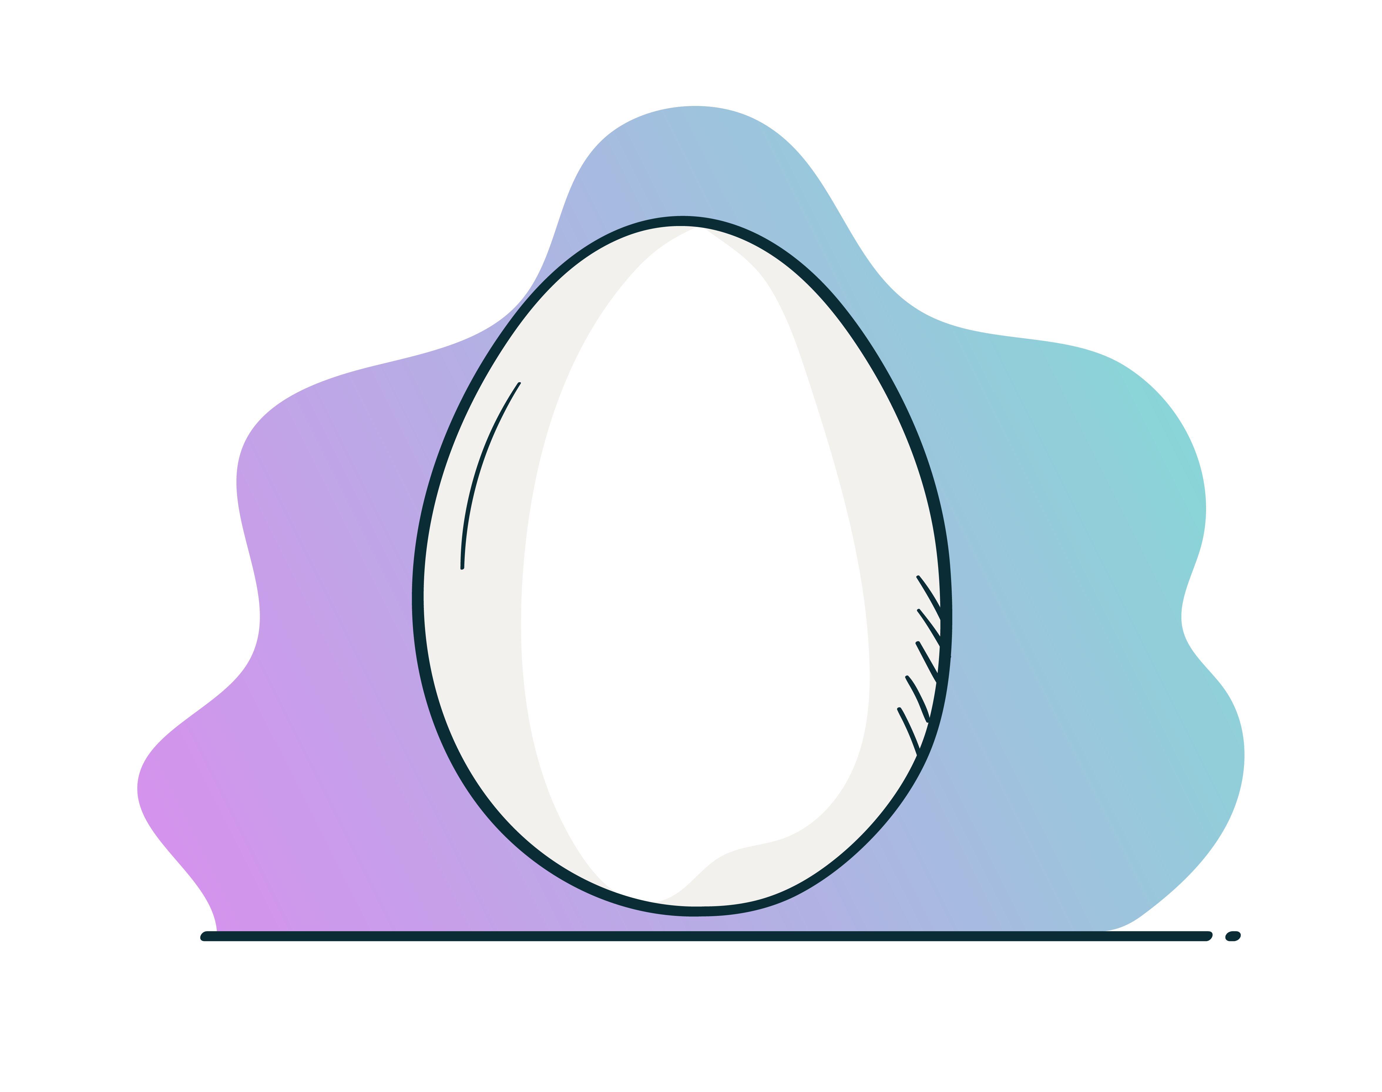
Progress Thus Far
Staking Layer
Orphic Finance Alpha Pool
Associated Wallet
Associated Wallet
User Wallet
Associated Wallet
Collateral
Associated Wallet

Slide 12

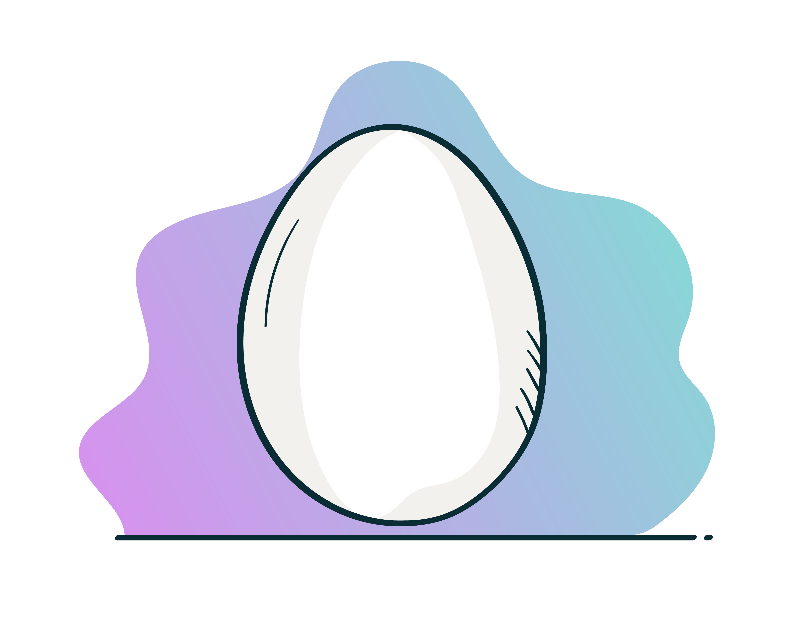



Reminder: Cosmic Eggs Workflow
??? How do I determine what the reward and value of each egg is???
Staking
Upon receipt, mint creates egg token (FT) in an associated account to “creator’s” wallet.
Egg
Mint
Egg
Mint+1
Egg
Mint+2
Egg
Mint+3
Egg
Mint+4
Egg
Mint+5
Egg is burnt, SOL (yolk + grail) is transferred to the user.
User initiates egg creation (by sending 10 SOL to Validator Wallet) and rent exemption.
Handler runs a CRON job to un-stake on receipt of egg.
Egg Wallet System
On Epoch change, Mint creates a new line of FTs (all FTs of same Epoch have same value)
Any SOL that is in the validator account gets staked.
User wants to redeem his egg for his SOL (yolk of 10 + grail/rewards). If no eggs in egg wallet – egg wallet closed and rent returned.
Epoch 1
2
3
4
5
6

